Slide 1

Cryptocurrency Analysis and
Price Prediction
Supervisor:
Dr: Samar Hesham
Eng: ALMohanad Alaa Eldeen

Slide 2

Cryptocurrency Analysis and
Price Prediction
Team Members:
Mohamed Yasser Mohamed 1900291
Angllios gergs nageh 1900647
Hashem mohamed 2000292
Ahmed dahy mohamed 2000381
Mohamed mousa 1901163
Mahmoud Gabriel Ahmed 2001002

Slide 3




Agenda
Introduction
Cryptocurrency Analysis
What is the cryptocurrency
Models
Problem Statement
Tools and Technologies
Related Work
Inputs and Outputs
Website

Slide 4

Introduction
Cryptocurrency has emerged as a revolutionary force in the world of finance, challenging traditional notions of currency and investment. With the advent of blockchain technology, decentralized ledgers, and smart contracts, cryptocurrencies offer a unique and transformative way to conduct financial transactions. This proposal aims to provide a comprehensive analysis of selected cryptocurrencies, coupled with a price prediction model to assist investors and enthusiasts in making informed decisions.

Slide 5

Cryptocurrency Web site
In this part, we utilized the following web languages: HTML, CSS, and JavaScript. Additionally, we incorporated the Google API to ensure real-time and up-to-date currency updates on the homepage. Furthermore, we added a "Join" page for new members to register, and a login page for existing members. Moreover, there's an analysis page displaying some general charts for cryptocurrencies.

Slide 6


Problem Statement
Crypto price volatility, fueled by unpredictable factors like policy shifts, tech advancements, and global economic swings, makes trading and investing risky. Current analysis tools struggle to capture these dynamic trends. To empower stakeholders with informed decisions, advanced price prediction strategies and models are desperately needed.

Slide 7
Problem Statement
This project explores the crypto market, analyzing historical data and trends to predict future prices. Using technical & fundamental analysis, we'll build models to forecast potential price movements. By providing accurate predictions, we aim to empower investors and traders in this complex market

Slide 8
Related Work
Predicting Cryptocurrency Prices using Twitter Sentiment Analysis:
Journal: 2021 IEEE 4th International Conference on Information Systems and Computer Aided Education (ISCAE)
Bitcoin Price Prediction through Machine Learning Analysis:
Book: Advances in Machine Learning and Data Science
Publisher: Springer Nature Switzerland

Slide 9
Inputs and Outputs
Inputs:
Market data:
Cryptocurrency prices (such as Bitcoin, Ethereum, and others) over time.
Past trading volumes and transactions.
Time-based data such as the specific time periods for analysis (daily, weekly, monthly).
Public market data and market news.
Economic and political events.
Volatility in the general market

Slide 10
Inputs and Outputs
Outputs:
Market analysis:
Reports and charts of trends and changes in prices.
Statistical results and information that have been acquired from data analysis.
Price predictions:
Predictions for prices in the future based on the predictive models used.
Reports and recommendations:
Detailed reports that explain the reasons, analyses, and recommendations derived from the results.

Slide 11
implementation
Website

Slide 12
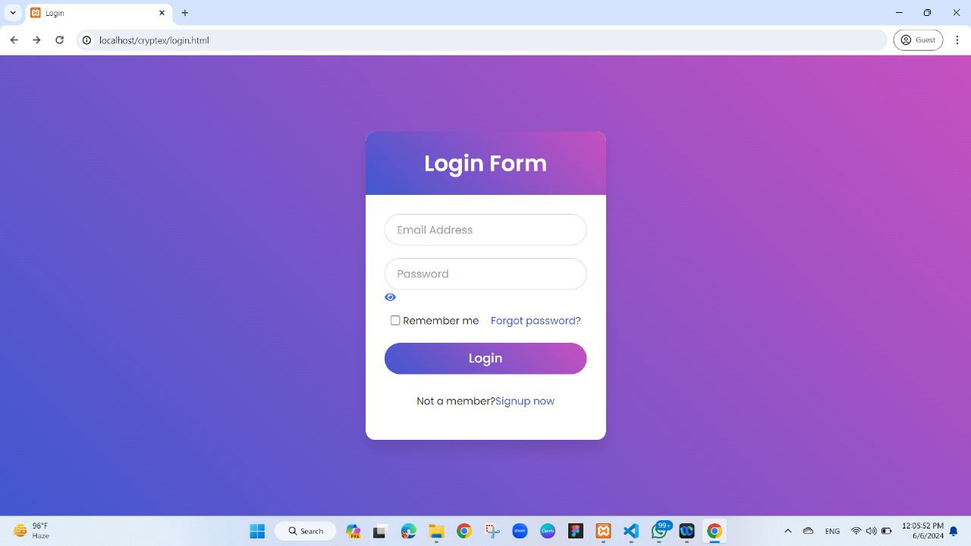
Log_in page
We've designed a login interface for the website using HTML, CSS, and JavaScript to ensure the security and safety of anyone accessing the site. Users are required to fill in two fields:
Email Address
Password
This is necessary in case the user is a returning visitor to the website

Slide 13
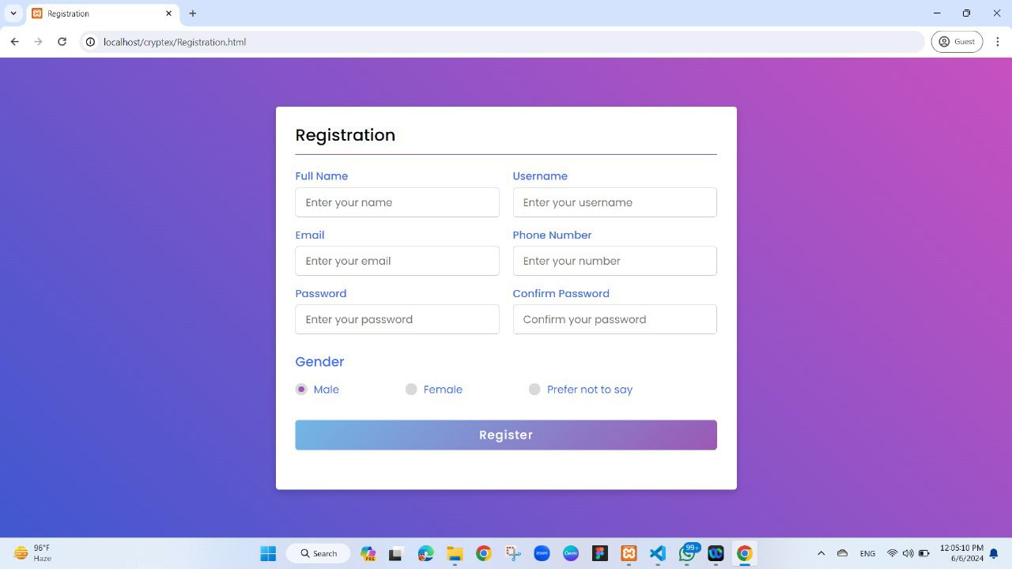
Registration_page
This window allows the new user to create his own account when entering the site for the first time by registering:
Full Name
Email
password
username
phone number
Confirm the password

Slide 14
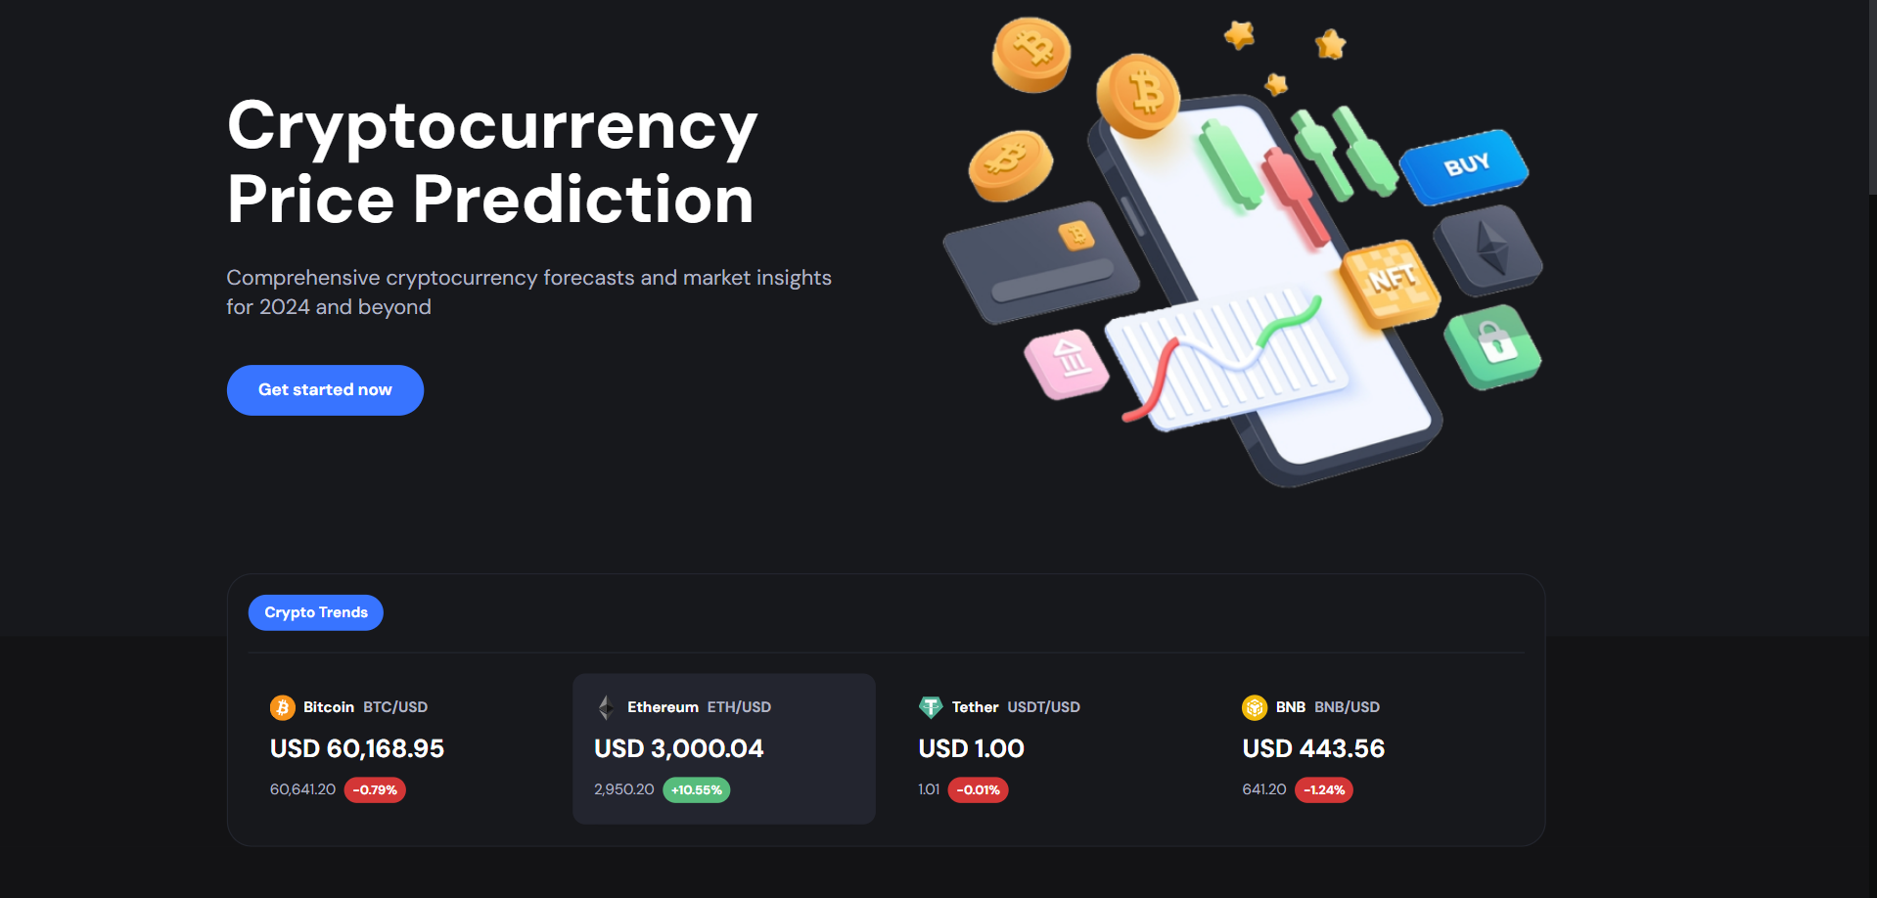
Home_page (part1)
The first part of the homepage is simple and includes the site's entry point and a brief introduction about the site. It serves as the main interface that users see upon logging in. Additionally, it features popular cryptocurrencies, including Bitcoin and others.

Slide 15
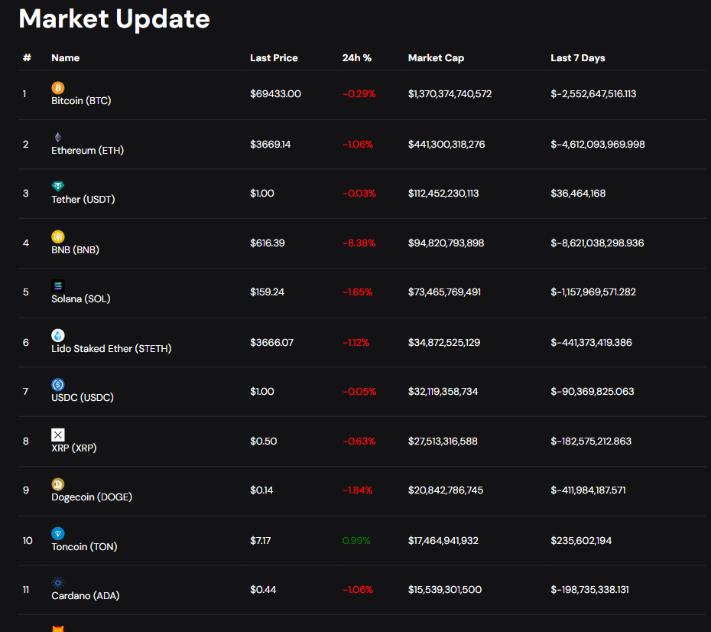
Home_page (part2)
The second part of the homepage highlights the core functionality of the site, which is the market section. This section is primarily connected to the internet via an API, specifically the )Coingecko API(, chosen for its accessibility and ease of data retrieval. The primary function of this API is to fetch data and update the HTML table with the latest cryptocurrency market data. This involves thoroughly analyzing the data to ensure that the currencies are displayed correctly. The site displays the latest current price, the highest price, the percentage change (whether it has increased or decreased), and the market price of the currency relative to the overall market.

Slide 16
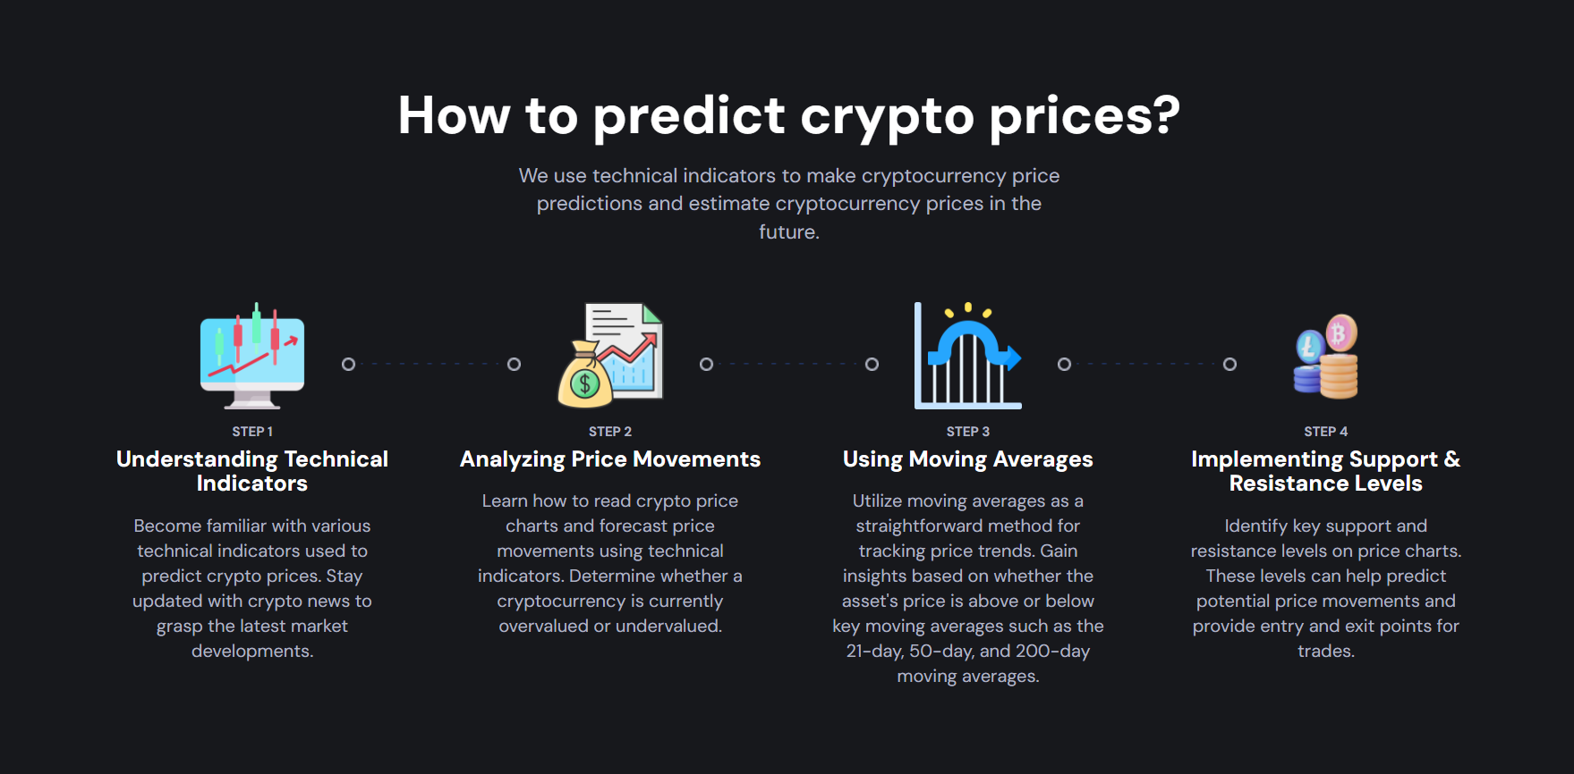
Home_page (part3)
This part is expected to get the user's chance of how to read and locate currencies through the wind chart and the previous table and through some preparation such as:
Understanding Technical Indicators
Analyzing Price Movements
Using Moving Averages
Implementing Support & Resistance Levels

Slide 17
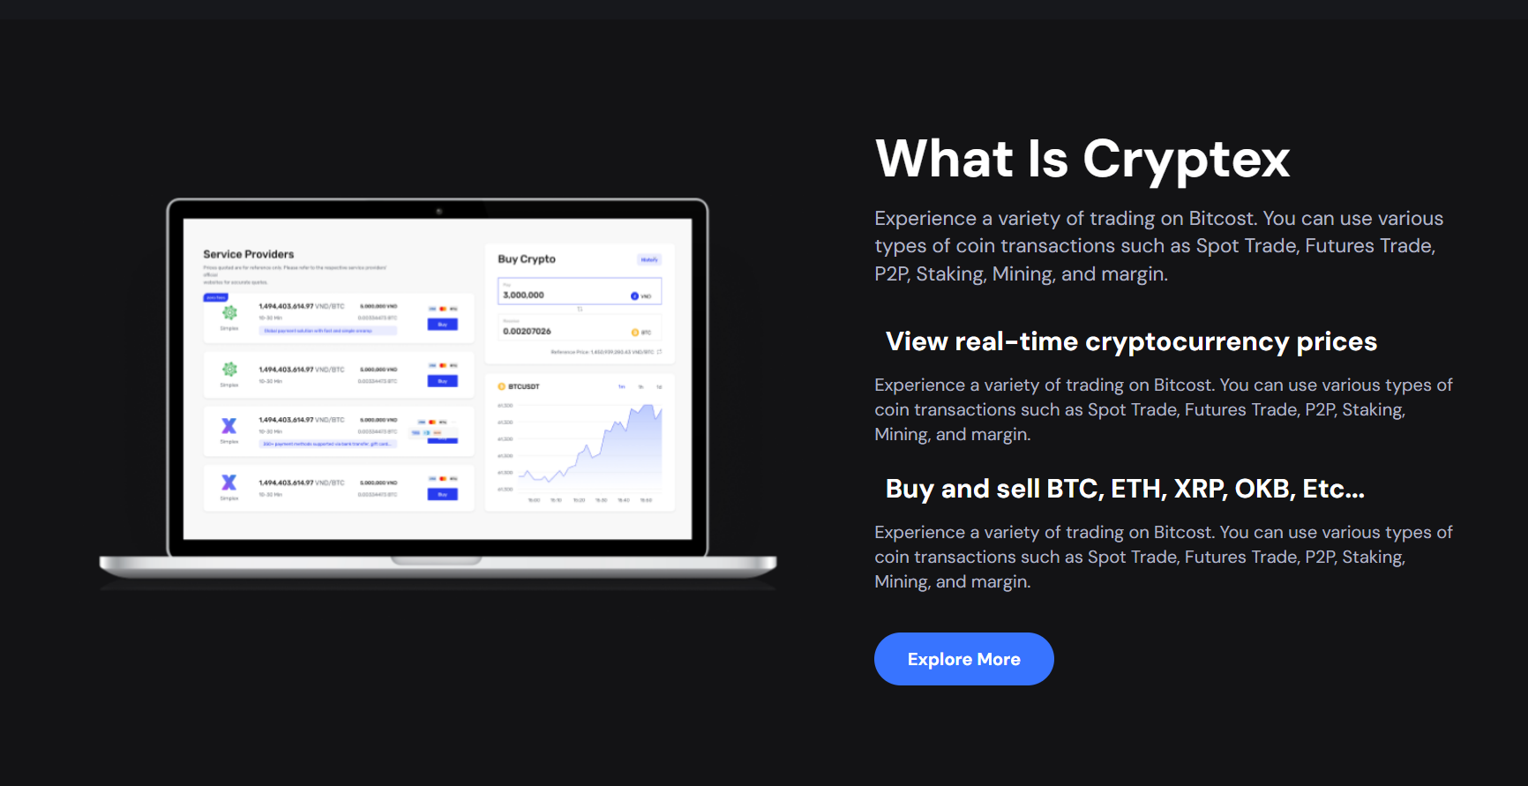
Home_page (part4)
In the last part, we make a simple explanation about digital currencies and currencies currently in the market, as well as how to read currency analyses.

Slide 18

About us _page
On the last page, we added information about the project in general and also about what the project does

Slide 19
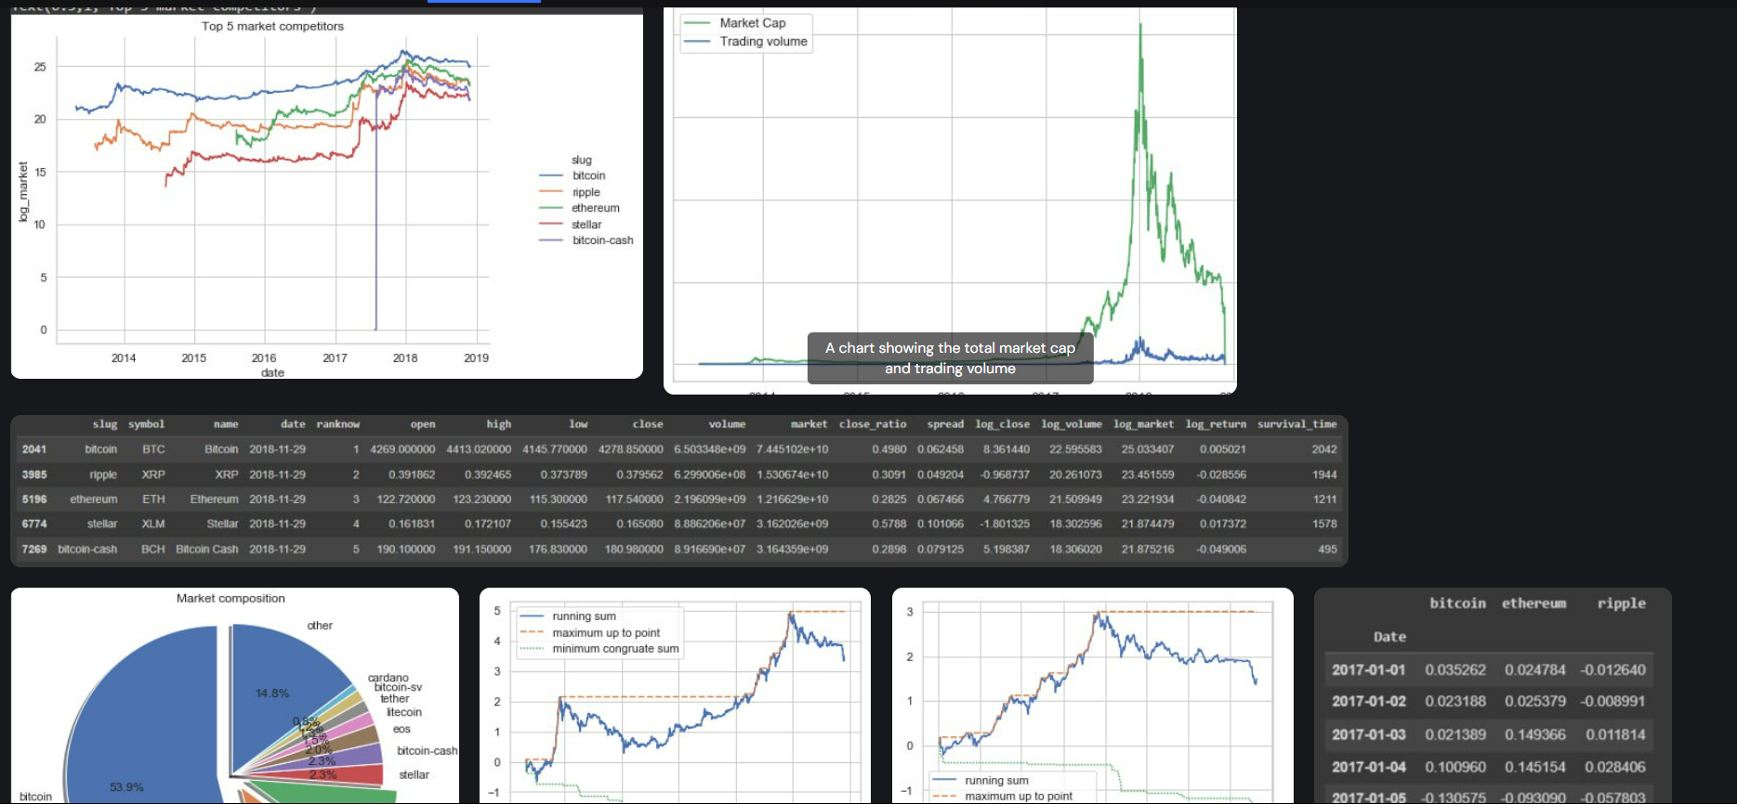
crypto_page
In this part, it is the basic science of the site, showing important movements in currencies, for example, the top 5 currencies that were dealt with
Existing and most famous currencies

Slide 20
Cryptocurrency Analysis
Leading market competitors:
Selecting the top 5 cryptos by ‘Ranknow’, then plot their market
size over time. We can see the dynamics: top 5 competitors are relatively stable over time. They
emerge from earlier 2014 to 2017. Bitcoin is leading the market, ripple recently surpasses
Ethereum to be at the second place.

Slide 21
Models
K-Means Clustering:
Unsupervised learning algorithm for grouping similar data points into clusters.
Used in the code to identify groups of cryptocurrencies with similar characteristics.
Principal Component Analysis (PCA):
Principal Component Analysis is a technique for dimensionality reduction, where a set of existing variables is transformed into a new set of variables (principal components) while preserving the maximum variance in the original data. PCA is used to simplify data and reduce complexity, making analysis and understanding processes easier. It is widely used in fields such as machine learning and data exploration.

Slide 22
Tools and Technologies
Google Colab
Python
HTML
CSS
JAVA SCRIPT

Slide 23


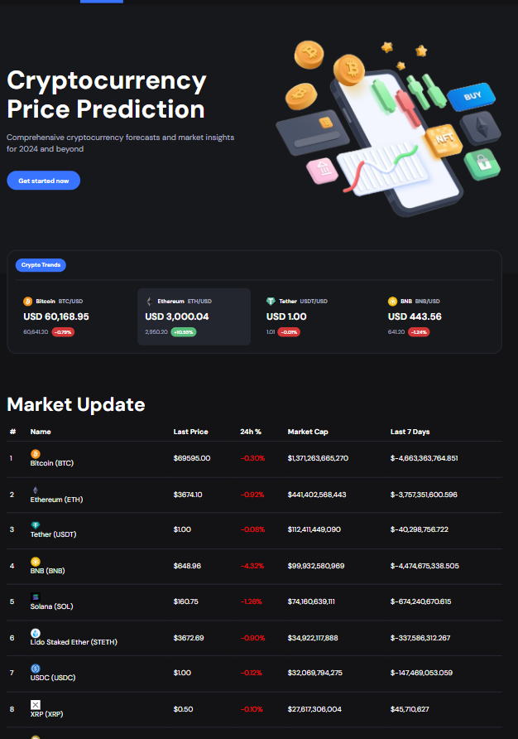
Cryptocurrency Analysis and
Price Prediction
In the end, this project is based on the idea of ​​displaying digital currencies, knowing their prices, and analyzing the data of those currencies. There is no way to trade on the site, including those who violate the state’s laws.

Slide 24
Thank You

